Slide 1


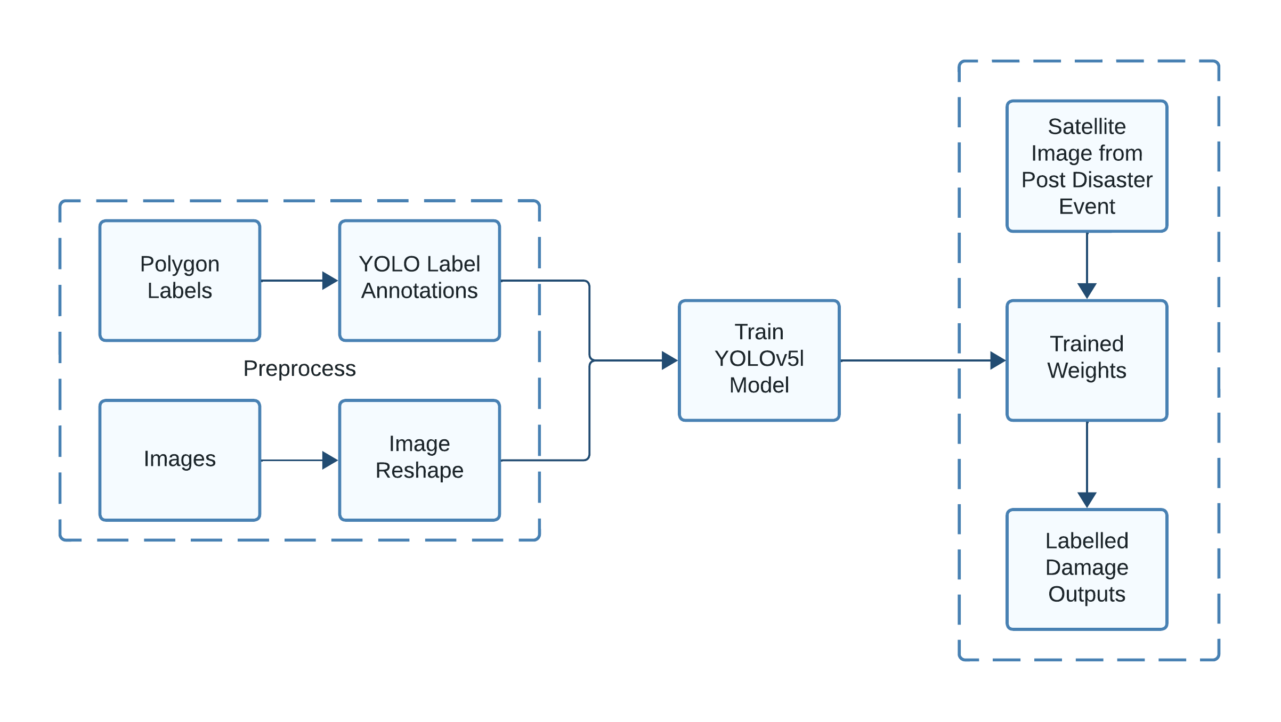
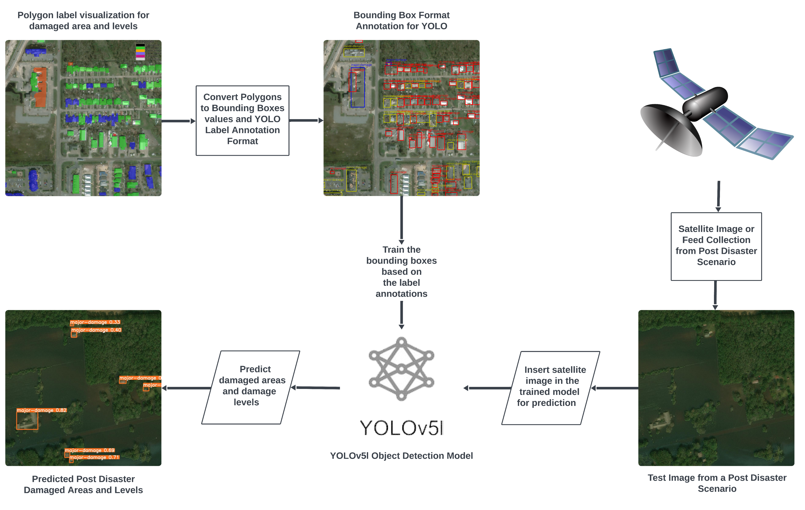
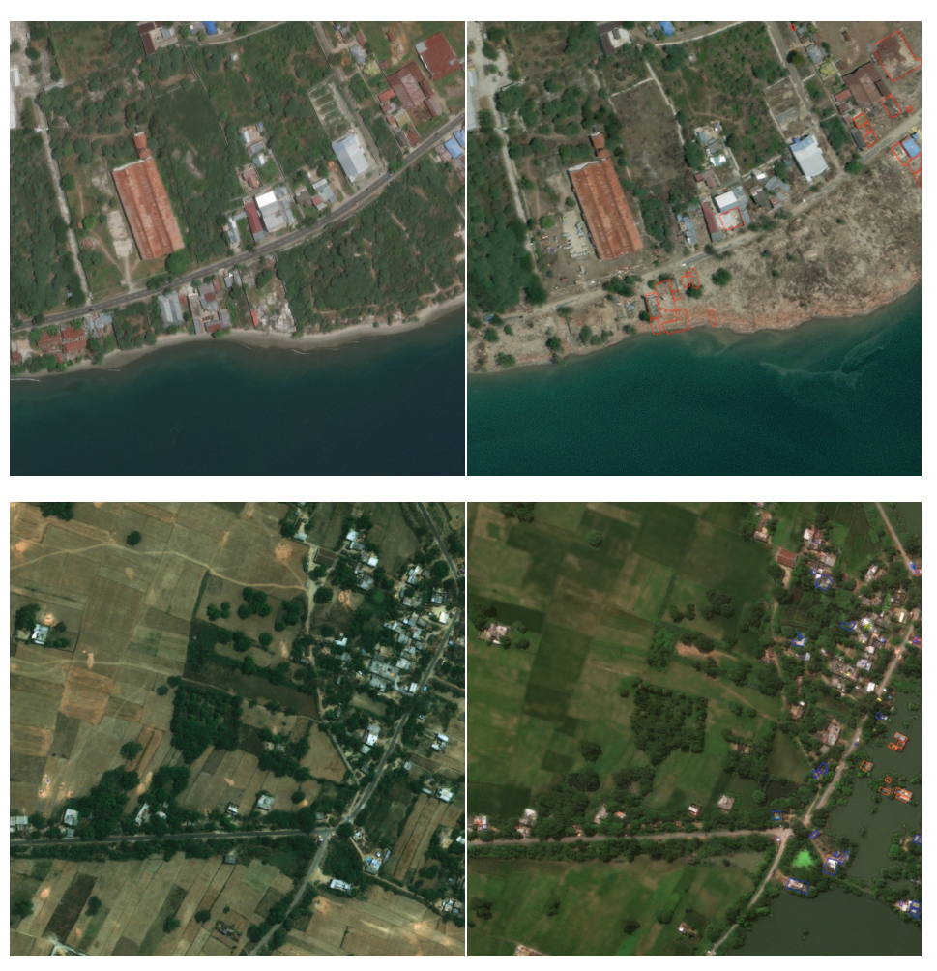
Leveraging YOLO v5 Object Detection on Satellite Imagery: A Comprehensive Building Damage Detection and Severity Assessment System for Post-Disaster Environments
By Abdullah Hel Asif & Shafin Ahmed Zidan
Advisor: Dr. Shahnewaz Siddique
Abstract
Methodology
Natural disasters are a plague that has haunted life on Earth from the beginning of time.
The basis of our work is the creation of a system that can detect and analyze the severity of damage on post-disaster environments caused by natural events. Our Deep Learning based system is able to recognize damaged buildings and surrounding areas caused due to earthquakes, floods, etc. from satellite images and simultaneously assign a damage severity rating to it.
Our project will allow aid workers and first respondents to efficiently distribute their resources based on degree of severity in the event of a natural disaster.
For our project we are using the YOLOv5 model. Our dataset is from the xView2 challenge which offers high-resolution satellite images annotated with building locations and damage scores from before and after various natural disasters.
The dataset contains polygon coordinates and damage grading as labels. We have converted the polygon coordinates into bounding box coordinates and then to YOLO label annotations. We are making the use of YOLOv5 because it is faster and more accurate compared to other object detecting models. There are different variants of the model which we can choose from but for now we are training on the YOLOv5l (large) model as our backbone.
Our AI system will take a satellite image or feed as input and based on the training it will show bounding boxes that will have buildings and their severity of the damage.
Motivation & Novelty
Planning for distribution of resources after a natural disaster can prove to be very difficult and putting first responders into post-disaster situations is very dangerous. Our work will solve this problem by performing damage detection and assessment to better understand the situation at hand and help provide an appropriate response.
Work related to this topic has been done before in other countries but it is completely new to the scene in Bangladesh.
Our unique way of implementation is a culmination of a lot of experimentation that hasn’t been seen before, especially given that it will eventually be tailored to fit the needs of Bangladesh.
This will allow the system to provide results that are as accurate as possible.
Process Diagram
Business Model
Our project’s business model is B2G(Business-to-Government). More specifically our plan is to target the Department of Disaster Management of Bangladesh.
Bangladesh is a country where natural disasters such as floods, earthquakes, etc. are very common, whereas the management of the after effects of these disasters are very poor. A system such as ours will provide the government with a way to quickly identify damaged areas that require focus and effectively provide assistance while saving time, resources and most importantly saving lives.4
The plan is to provide the government with a service that is either subscription based or to sell the system to them as a whole.
Dataset
Conclusion
We collected our data from xBD dataset which contains pre and post satellite images from natural disasters. It contains about 700,000 labeled building instances covering over 5,000 km² of imagery.
The dataset consists of building polygons that are granular representations of a building’s footprint, ordinal regression labels for damage, which rate how damaged a building is on an increasing integer scale, multi-class labels, which relate all the environmental factors that caused the damage seen in the imagery and environmental factor bounding boxes and labels.
At this primary stage, we have implemented the proper detection of the damages from the satellite images and we are striving further on improving the accuracy of detection of the damage severity.
The end goal is to make use of our system on a satellite imagery dataset based completely on the landscape of Bangladesh so that our system may function at its best for its intended purpose.

